Slide 1

ATTENDANCE TRACKER
CMPE 297
ABHIJITSINH CHAVDA
TIFFANY LEE
STERLING TARNG

Slide 2
THE ISSUE
Attendance is tedious to take in class
Statistics show teachers spend around 5 minutes on average to take roll
Paper attendance: not efficient, manual entry
THE SOLUTION: A beacon that can detect students’ mobile phones and instantly track their presence in the classroom

Slide 3
FEATURES
Student | Professor
Register with Name & Student ID | Dashboard to query database
Phone automatically sends Device ID | Set time interval for beacon detection
Minimal User Interaction
Notes:
Registration: Name & Student ID
Each phone has unique ID, so cannot ‘pretend’ to be someone else
Can choose the time period that the beacon detects and updates roster
Minimum user Interaction
Dashboard to Query the database.

Slide 4
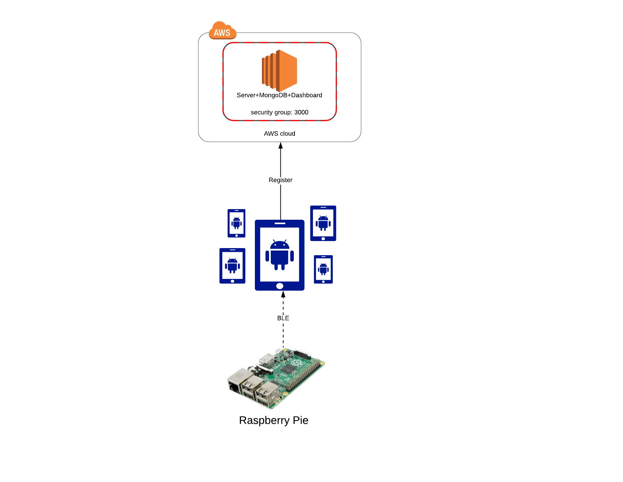
ARCHITECTURE DIAGRAM

Slide 5
TECHNOLOGIES USED
Modified Raspberry Pi to work as a Beacon
Bluetooth and Location Services on Smartphone
Mobile App
MongoDB & Server

Slide 6
FUTURE POTENTIAL
iBeacon & iPhone implementation
Two-Way Connection: Only those in range can have access
Employee Tracking
Population / Capacity Tracker
Real-Time Locating, Out of Range Detection
Notes:
Two way connection: students can receive quizzes or material based on if they are in the classroom
Also: museum guides: can provide information about what exhibit they are looking at based on proximity to a display

